Slide 1

Sales Analysis of Adventure Works Cycles: using SQL and Power Bi
Prepared by Group 2:
Amr Mahmoud Mohamed Aly
Doaa Wafek Mohamed
Wesam Mohamed Saad
Hend Ahmed Mohamed ElGhazaly
Sabry Elsayed Ali Mashaal

Slide 2

About Adventure Works Cycles
Adventure Works is fictional global manufacturing company that produces cycling equipment and accessories.

Slide 3
Methods and Tools:
Team has used the following tools in order to provide an analysis of sales data of Adventure Works Cycles company.
using SQL, after using Power Query for data cleaning.
displaying the analysis and insights with Power Bi.

Slide 4
Objective and Insights:
Around 25 sales analysis and insights for Adventure Works Cycles were achieved by the team using SQL, here are some insights, that will be discussed in detail in the upcoming slides:
Total Sales by Salesperson
Sales Trend Over Time
Average Sales per Reseller
Sales by Business Type
Reseller Sales by Product
Target Achievement by Salesperson

Slide 5


SQL Insights (codes and tables)

Slide 6
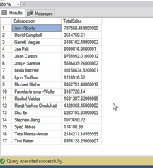
1-Total Sales by Salesperson – Analyz the total sales amount for each salesperson.
SELECT Salesperson.Salesperson, SUM(Sales.Sales) AS TotalSales
FROM Sales
JOIN Salesperson ON Sales.EmployeeKey = Salesperson.EmployeeKey
GROUP BY Salesperson.Salesperson

Slide 7
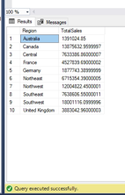
2-Sales Performance by Region – Compare sales performance across different regions.
SELECT Region.Region, SUM(Sales.Sales) AS TotalSales
FROM Sales
JOIN Region ON Sales.SalesTerritoryKey = Region.SalesTerritoryKey
GROUP BY Region.Region

Slide 8
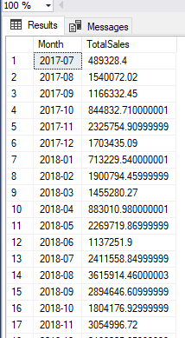
3- Sales Trend Over Time – Track how sales have fluctuated month-over-month.
SELECT FORMAT(OrderDate, 'yyyy-MM') AS Month, SUM(Sales) AS TotalSales
FROM Sales
GROUP BY FORMAT(OrderDate, 'yyyy-MM’)
ORDER BY FORMAT(OrderDate, 'yyyy-MM’)

Slide 9
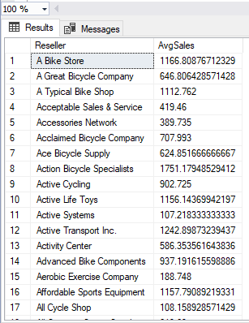
4- Average Sales per Reseller – Find out the average sales for each reseller.
SELECT Reseller.Reseller, AVG(Sales.Sales) AS AvgSales
FROM Sales
JOIN Reseller ON Sales.ResellerKey = Reseller.ResellerKey
GROUP BY Reseller.Reseller

Slide 10
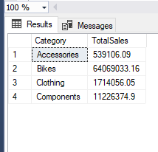
5- Sales per Product Category – Analyze which product categories contribute the most to overall sales.
SELECT Product.Category, SUM(Sales.Sales) AS TotalSales
FROM Sales
JOIN Product ON Sales.ProductKey = Product.ProductKey
GROUP BY Product.Category

Slide 11
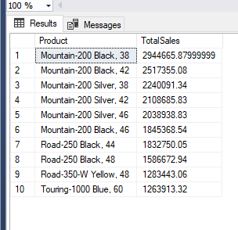
6- Top 10 Products by Sales – Identify the top-selling products.
SELECT TOP 10 Product.Product,SUM(Sales.Sales) AS TotalSales
FROM Sales
JOIN Product ON Sales.ProductKey = Product.ProductKey
GROUP BY Product.Product
ORDER BY TotalSales DESC

Slide 12
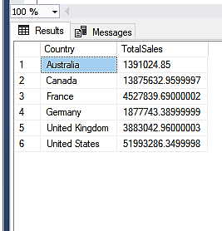
7- Sales by Country – Compare total sales per country or country region.
SELECT Region.Country, SUM(Sales.Sales) AS TotalSales
FROM Sales
JOIN Region ON Sales.SalesTerritoryKey = Region.SalesTerritoryKey
GROUP BY Region.Country

Slide 13
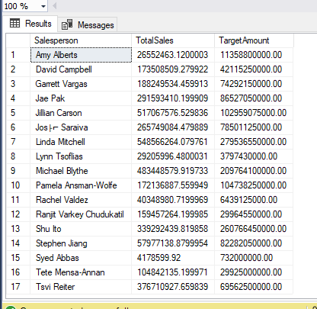
8- Sales vs Target Performance – Measure whether salespeople are meeting their targets for each month.
SELECT Salesperson.Salesperson, SUM(Sales.Sales) AS TotalSales, SUM(Targets.Target) AS TargetAmount
FROM Sales
JOIN Salesperson ON Sales.EmployeeKey = Salesperson.EmployeeKey
JOIN Targets ON Salesperson.EmployeeID = Targets.EmployeeID
GROUP BY Salesperson.Salesperson

Slide 14
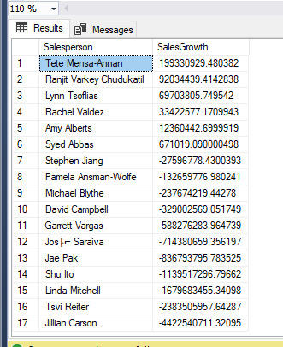
9- Salesperson with Highest Sales Growth – Analyze which salesperson has shown the most growth over time.
SELECT Salesperson.Salesperson,(SUM(Sales.Sales) - SUM(PreviousSales.Sales)) AS SalesGrowth
FROM Sales
JOIN Salesperson ON Sales.EmployeeKey = Salesperson.EmployeeKey
JOIN Sales AS PreviousSales ON Sales.EmployeeKey = PreviousSales.EmployeeKeyAND DATEPART(YEAR, Sales.OrderDate) = DATEPART(YEAR, PreviousSales.OrderDate) + 1
GROUP BY Salesperson.Salesperson
ORDER BY SalesGrowth DESC

Slide 15
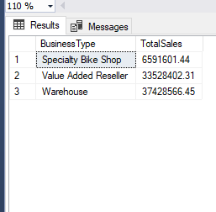
10-Sales by Business Type – Analyze sales performance based on the business type of resellers.
SELECT Reseller.BusinessType, SUM(Sales.Sales) AS TotalSales
FROM Sales
JOIN Reseller ON Sales.ResellerKey = Reseller.ResellerKey
GROUP BY Reseller.BusinessType

Slide 16
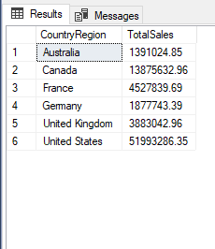
11-Reseller Performance by Country – Compare the performance of resellers from different countries.
SELECT Reseller.CountryRegion, SUM(Sales.Sales) AS TotalSales
FROM Sales
JOIN Reseller ON Sales.ResellerKey = Reseller.ResellerKey
GROUP BY Reseller.CountryRegion

Slide 17
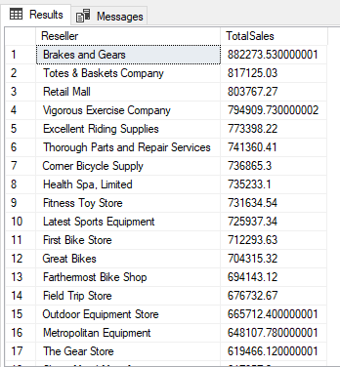
12-Top Resellers by Sales – Identify resellers contributing the most to sales.
SELECT Reseller.Reseller, SUM(Sales.Sales) AS TotalSales
FROM Sales
JOIN Reseller ON Sales.ResellerKey = Reseller.ResellerKey
GROUP BY Reseller.Reseller
ORDER BY TotalSales DESC

Slide 18
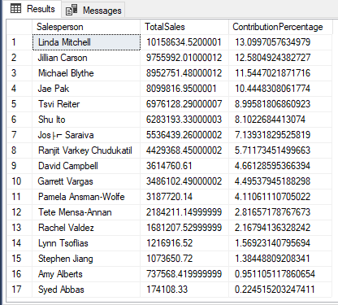
13-Salesperson Contribution to Company Sales – Find out the contribution of each salesperson to the overall sales.
SELECT Salesperson.Salesperson, SUM(Sales.Sales) AS TotalSales, (SUM(Sales.Sales) / (SELECT SUM(Sales) FROM Sales)) * 100 AS ContributionPercentage
FROM Sales
JOIN Salesperson ON Sales.EmployeeKey = Salesperson.EmployeeKey
GROUP BY Salesperson.Salesperson
ORDER BY ContributionPercentage DESC

Slide 19
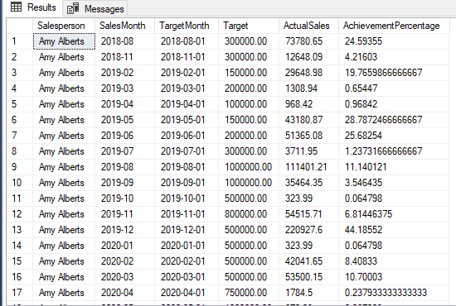
14-Target Achievement by Salesperson – Compare each salesperson’s performance against their target goals for each month.
SELECT Salesperson.Salesperson, FORMAT(Sales.OrderDate, 'yyyy-MM') AS SalesMonth,Targets.TargetMonth, Targets.Target, SUM(Sales.Sales) AS ActualSales, (SUM(Sales.Sales) / Targets.Target) * 100 AS AchievementPercentage
FROM Sales
JOIN Salesperson ON Sales.EmployeeKey = Salesperson.EmployeeKey
JOIN Targets ON Salesperson.EmployeeID = Targets.EmployeeID AND FORMAT(Sales.OrderDate, 'yyyy-MM') = FORMAT(Targets.TargetMonth, 'yyyy-MM')
GROUP BY Salesperson.Salesperson, FORMAT(Sales.OrderDate, 'yyyy-MM'), Targets.TargetMonth, Targets.Target
ORDER BY Salesperson.Salesperson, SalesMonth;

Slide 20
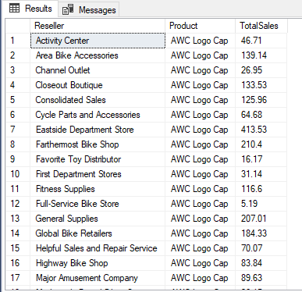
15- Reseller Sales by Product – Understand which resellers prefer which products.
SELECT Reseller.Reseller, Product.Product, SUM(Sales.Sales) AS TotalSales
FROM Sales
JOIN Reseller ON Sales.ResellerKey = Reseller.ResellerKey
JOIN Product ON Sales.ProductKey = Product.ProductKey
GROUP BY Reseller.Reseller, Product.Product

Slide 21
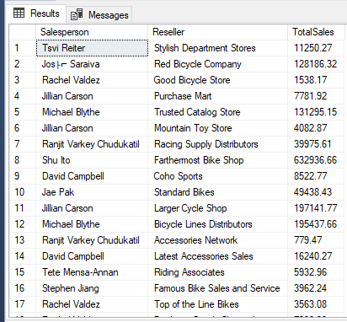
16- Reseller Contribution to Salesperson Performance – Evaluate the impact of resellers on a salesperson’s performance.
SELECT Salesperson.Salesperson, Reseller.Reseller, SUM(Sales.Sales) AS TotalSales
FROM Sales
JOIN Salesperson ON Sales.EmployeeKey = Salesperson.EmployeeKey
JOIN Reseller ON Sales.ResellerKey = Reseller.ResellerKey
GROUP BY Salesperson.Salesperson, Reseller.Reseller

Slide 22
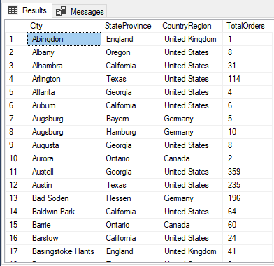
17- Sales Orders by Reseller Location – Map the geographic distribution of reseller sales orders.
SELECT Reseller.City, Reseller.StateProvince, Reseller.CountryRegion,COUNT(Sales.SalesOrderNumber) AS TotalOrders
FROM Sales
JOIN Reseller ON Sales.ResellerKey = Reseller.ResellerKey
GROUP BY Reseller.City, Reseller.StateProvince, Reseller.CountryRegion

Slide 23
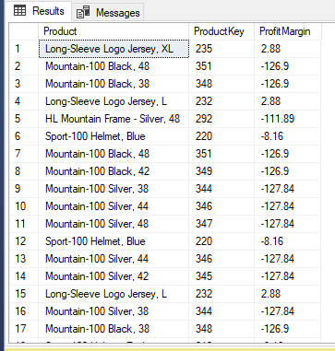
18-Profit Margin per Product – Calculate profit margins by subtracting cost from sales and compare across products. .
SELECT Product.Product, product.ProductKey,( Product.StandardCost - Sales.UnitPrice) AS ProfitMargin
FROM Sales
JOIN Product ON Sales.ProductKey = Product.ProductKey

Slide 24
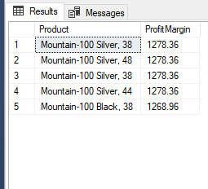
19- Top 5 Products by Profit Margin – Identify products that bring the highest profit margins.
SELECT TOP 5 Product.Product, (Sales.Sales - Sales.Cost) AS ProfitMargin
FROM Sales
JOIN Product ON Sales.ProductKey = Product.ProductKey
ORDER BY ProfitMargin DESC

Slide 25
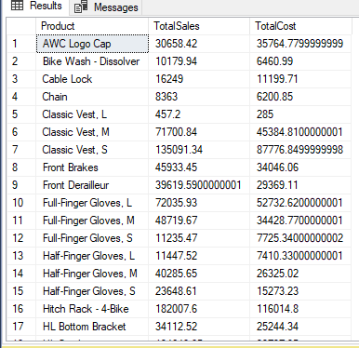
20- Cost vs Sales Analysis by Product – Compare cost vs total sales per product.
SELECT Product.Product, SUM(Sales.Sales) AS TotalSales, SUM(Sales.Cost) AS TotalCost
FROM Sales
JOIN Product ON Sales.ProductKey = Product.ProductKey
GROUP BY Product.Product

Slide 26
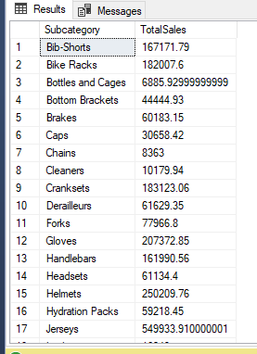
21- Sales by Product Subcategory – Analyze sales performance at the subcategory level.
SELECT Product.Subcategory, SUM(Sales.Sales) AS TotalSales
FROM Sales
JOIN Product ON Sales.ProductKey = Product.ProductKey
GROUP BY Product.Subcategory

Slide 27
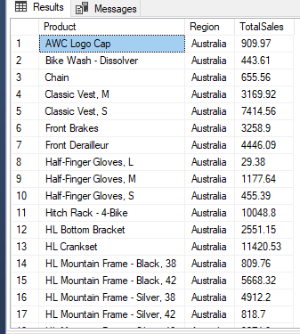
22- Product Sales by Region – Compare product performance across regions.
SELECT Product.Product, Region.Region, SUM(Sales.Sales) AS TotalSales
FROM Sales
JOIN Product ON Sales.ProductKey = Product.ProductKey
JOIN Region ON Sales.SalesTerritoryKey = Region.SalesTerritoryKey
GROUP BY Product.Product, Region.Region

Slide 28
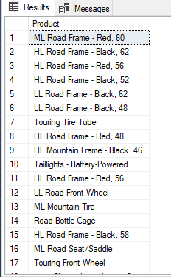
23- Unsold Products – Identify products that have not been sold over a specific period.
SELECT Product.Product
FROM Product
LEFT JOIN Sales ON Product.ProductKey = Sales.ProductKey
WHERE Sales.Sales IS NULL

Slide 29
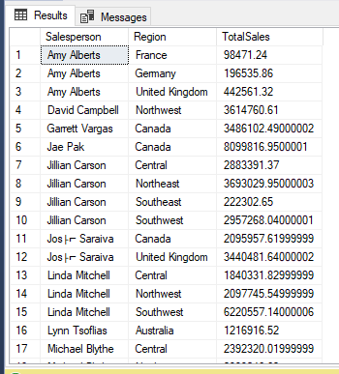
24- Salesperson Sales per Region – Analyze how each salesperson is performing in various regions.
SELECT Salesperson.Salesperson, Region.Region, SUM(Sales.Sales) AS TotalSales
FROM Sales
JOIN Salesperson ON Sales.EmployeeKey = Salesperson.EmployeeKey
JOIN Region ON Sales.SalesTerritoryKey = Region.SalesTerritoryKey
GROUP BY Salesperson.Salesperson, Region.Region
ORDER BY Salesperson.Salesperson, Region.Region;

Slide 30
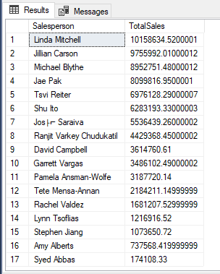
25- Top Performing Salespeople – Identify salespeople with the highest sales figures.
SELECT Top 20 Salesperson.Salesperson, SUM(Sales.Sales) AS TotalSales
FROM Sales
JOIN Salesperson ON Sales.EmployeeKey = Salesperson.EmployeeKey
GROUP BY Salesperson.Salesperson
ORDER BY TotalSales DESC

Slide 31
Q&A THANK YOU!

